Slide 1
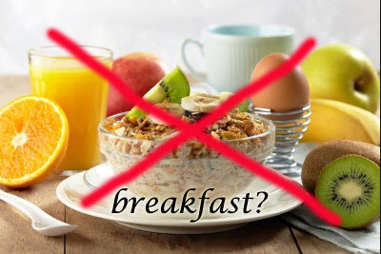
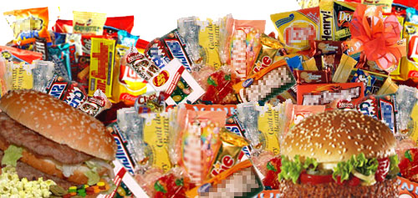

EATING HABITS - PART I SKIPPING BREAKFAST AND JUNK FOOD CONSUMPTION
HEALTH AND LIFESTYLE
Class - 10

Slide 2


Breakfast is the most important meal of the day.
The side effects of not eating breakfast negatively
impact weight, hormonal health, memory, cognition and mood.
While skipping breakfast may be common, it's both a bad habit and a significant health risk. That's because eight to 10 hours after a meal, your body begins losing energy.
Starvation mode kicks in and your body begins switching over to survival mechanisms. That means it begins pulling fuel from fat cells and sending it to the liver to be converted into energy.
This may sound good on the surface, but it's actually an inefficient process that slows down your overall metabolism, leads to poor regulation of blood sugar and thus can increase your risk for diabetes.

Slide 3
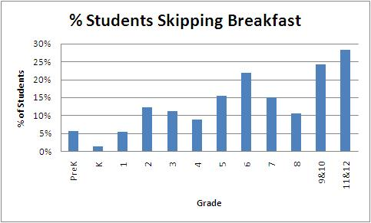

Slide 4
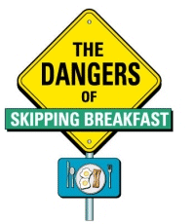


Slide 5
COMPLICATIONS OF SKIPPING BREAKFAST
Headaches and fatigue. In a surprising number of cases, patients with chronic headaches and fatigue got rid of both problems once they began eating breakfast. Try eating a light, nutritious morning meal for a week or two before you invest in more headache medicine.
Fuzzy thinking. Without fuel, you're asking your brain to perform without an optimum amount of glucose. You can get through the day, but you won't have the level of cognitive performance and reasoning skills that you would if you ate a proper breakfast. Try eating breakfast regularly before you automatically assume
you're not a morning person.
Nutritional shortcomings. People who routinely skip breakfast are often lacking in many vitamins and minerals, as well as protein and complex carbohydrates.

Slide 6
High cholesterol. Breakfast skippers also have higher cholesterol rates than those who eat in the morning because most of them snack later on fatty, high-calorie foods.
Obesity. Skipping breakfast slows the rate at the body burns calories. Most people become hungry by mid-morning, making them more likely to overeat at lunchtime and/or snack on junk foods.
Changing your routine to include breakfast can mean significant improvements in your overall health and feelings of well-being. But make sure your choices are healthy. Pastries, sweetened cereals, fast foods or coffee and juice alone aren't the best options. Instead, try fresh fruit, healthy proteins like soy milk, nuts and yogurt, and complex carbohydrates such as whole-grain cereals, bagels, rice or millet.

Slide 7
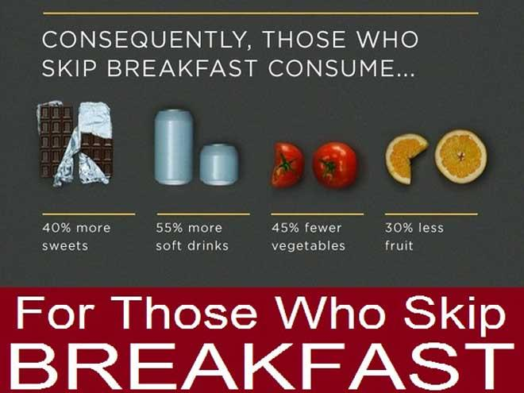

Slide 8

FAST FOOD CONSUMPTION

Slide 9
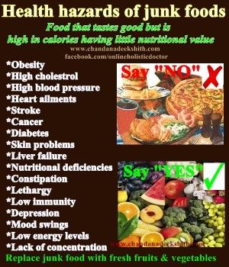

Slide 10
Fast Food and the Risk of Illness and Disease
Eating fast foods has been linked to a number of different health conditions.
Some of these conditions may lead to permanent disability or even death.
It is important for people to be aware of the risks of illness and disease related to the consistent consumption of fast foods. The health conditions linked to fast food consumption include the following:
Stroke: A diet of fast foods many times leads to high blood pressure which, in turn, is a leading risk factor for stroke.
Obesity: The NIH also states that consuming fast food can lead to obesity. One study discovered that a person who eats fast food at least twice a week will gain at least ten extra pounds.

Slide 11
Type 2 Diabetes: The National Institutes of Health (NIH) states that fast food consumption is strongly associated with insulin resistance, something that greatly increases a person's risk of developing type 2 diabetes.
Cardiovascular Disease: Eating an unhealthy diet filled with fast foods is a leading contributor to cardiovascular disease. The condition is caused by the buildup of plaque in a person's arteries and might lead to heart failure.
Cancer: According to Corporate Accountability International, one-third of cancers are related to poor diet, such as the kind of diet to be found through consuming fast foods. This is many times paired with the fact that obesity is closely linked with cancers of the kidney, colon, as well as esophagus.

